Slide 1
Functional Programming in Java
Ayan Sengupta

Slide 2
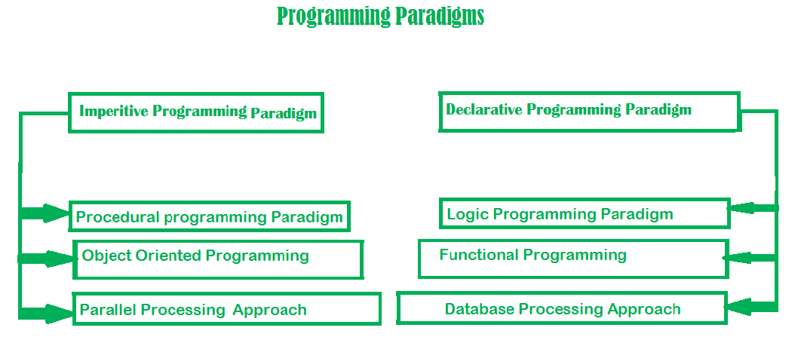
imperative approach defines a program as a sequence of statements that change the program’s state until it reaches the final state. Focuses on HOW
In contrast, the declarative approach expresses the logic of a computation without describing its control flow. Focuses on WHAT

Slide 3
Fundamentals
In functional programming, functions are first-class citizens, meaning that they can be passed around as values, stored in variables or data structures, and used as arguments or return values of other functions.
The function interface provides a way to define and manipulate functions in Java code. Any interface with a single abstract method can serve as a functional interface
Higher-order functions are capable of receiving functions as arguments and returning a function as a result.
a pure function should return a value based only on the arguments and should have no side effects. (i.e.) modifying global or local state or saving data to a database or disk. Pure functions can be run in parallel without race condition or data corruption. See here
An expression is referentially transparent if it can be replaced with its corresponding value without changing the program's behavior. If all functions involved in the expression are pure and immutable functions, then the expression is referentially transparent See here

Slide 4
Functional Programming Paradigm | Object-Oriented Programming Paradigm
Functional programming follows declarative programming paradigm. | Object-Oriented programming follows imperative programming paradigm.
Functional programming uses immutable data. | Object-Oriented programming uses mutable data.
Functional programming supports parallel programming. | Object-Oriented programming doesn't support parallel programming.
Functional programming operates on variables and functions. | Object-Oriented programming operates on objects and methods.
Functional programming uses recursion for iteration. | Object-Oriented programming uses loops for iteration.
Functional programming is stateless. | Object-Oriented programming is stateful.

Slide 5
Advantages of the Functional Programming
Functional programming uses pure functions, which only depend on the input parameters passed to the function and always produced the same output for the given input.
Functional programming deals with immutable data (i.e.) the state doesn't change, so it is easier to debug.
Functional programming supports parallel programming because pure functions don't change the state and operate exclusively on the input parameters.
Functional programming supports lazy evaluation, which avoids unwanted and repeated computations and saves time.
Functional programming is thread-safe because pure functions don't modify the state of a program, and there is no shared state.
In functional programming, functions can be stored in variables and passed to other functions. This enhances the readability of code.

Slide 6
Functional Interfaces in Java
A functional interface is an interface that contains single abstract method. They can have only one functionality to exhibit. From Java 8 onwards, lambda expressions can be used to represent the instance of a functional interface. A functional interface can have any number of default methods
Consumer : accepts only one argument and returns nothing.
Variants : BiConsumer, DoubleConsumer, IntConsumer, and LongConsumer
Example : Consumer<Integer> display = a -> System.out.println(a);
display.accept(10);
Supplier : does not take any input or argument and yet returns a single output
Variant : BooleanSupplier, DoubleSupplier, LongSupplier, and IntSupplier
Example : Supplier<Double> randomValue = () -> Math.random();
System.out.println(randomValue.get());
Predicate : accepts an argument and, in return, generates a boolean value
Variants : BiPredicate, IntPredicate, DoublePredicate, and LongPredicate
Example : Predicate<Integer> lesserthan = i -> (i < 18);
System.out.println(lesserthan.test(10));
Function : receives only a single argument and returns a value after the required processing
Variants : BiFunction, Operator (UnaryOperator and BinaryOperator) extends Function and must return the same data type
Example : Function<Integer, Integer> square = x -> x*x;

Slide 7
Lambdas
Lambda Expression basically expresses an instance of the functional interface, in other words, you can say it provides a clear and concise way to represent a method of the functional interface using an expression.
1. Lambda Expression with Zero parameter
() -> System.out.println("Zero parameter lambda");
2. Lambda Expression with Single parameter
p -> System.out.println("One parameter: " + p);
3. Lambda Expression with Multiple parameters
(p1, p2) -> System.out.println("Multiple parameters: " + p1 + ", " + p2);

Slide 8
Monad and Optional
Monad is a key concept of Functional Programming. A Monad is a design pattern which helps to represent a missing value. It allows to wrap a potential null value, allows to put transformation around it and pull actual value if present
Key Operations
Left Identity − If a function is bind on a monad of a particular value then its result will be same as if function is applied to the value.
Right Identity − If a monad return method is same as monad on original value.
Associativity − Functions can be applied in any order on a monad.
Optional Class
Java 8 introduced Optional class which is a monad. It provides operational equivalent to a monad.

Slide 9
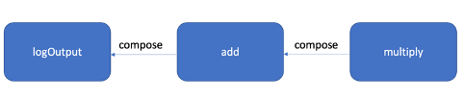
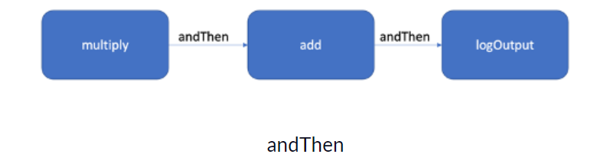
Function Composition and Chaining
Function chaining is a technique in functional programming that involves composing multiple functions into a single pipeline or chain.
private static Function<Integer, Integer> multiply = x -> x * 2;
private static Function<Integer, Integer> add = x -> x + 2;
private static Function<Integer, Unit> logOutput = x ->{ logger.info("Data:" + x); return Unit.unit(); };
public static Unit execute(Integer input) {
Function<Integer, Unit> pipeline = multiply
.andThen(add)
.andThen(logOutput);
return pipeline.apply(input);
}
public static Unit compose(Integer input) {
Function<Integer, Unit> pipeline = logOutput
.compose(add)
.compose(multiply);
return pipeline.apply(input); }

Slide 10
Customized Functional Interface
Function<String, String> toUpper = str -> str.toUpperCase();
BiFunction<Integer, Integer, Integer> sum = (a, b) -> a + b;
The Function interface takes a single input and produces an output, whereas the BiFunction interface takes two inputs and produces an output.
if we need a function that takes three inputs, we must construct our own customized function.
@FunctionalInterface
public interface TriFunction<A, B, C, O> {
O apply(A a, B b, C c);
default <R> TriFunction<A, B, C, O> andThen(TriFunction<A, B, C, O> after)
{
return (A a, B b, C c) -> after.apply(a,b,c);
}
}

Slide 11
Function Currying
Currying is converting a function with multiple arguments into multiple functions with a single argument.
public static void main(String[] args) {
//using java.util.function.BiFunction
BiFunction<String, String, String> concatWithBiFunction = (a,b) -> a+b;
//Currying is converting a function with multiple arguments into multiple functions with a single argument.
Function<String, Function<String, String>> concatCurried = a -> b -> a + b;
System.out.println("concatWithBiFunction: " + concatWithBiFunction.apply("A", "B"));
System.out.println("concatCurried: " + concatCurried.apply("A").apply("B"));
}

Slide 12
References
https://www.tutorialspoint.com/functional_programming_with_java/index.htm
https://www.freecodecamp.org/news/functional-programming-in-java/#:~:text=In%20functional%20programming%2C%20functions%20are,manipulate%20functions%20in%20Java%20code.
https://www.baeldung.com/java-functional-programming
https://www.geeksforgeeks.org/functional-programming-in-java-with-examples/
https://www.scaler.com/topics/java/functional-programming-in-java/

